Slide 1

university of Europe for applied sciences Department of Data Science
Presentation On: progress report Twitter (X) Real-Time Data Engineering Pipeline
PRESENTED BY:
Anish Dadaji Khobragade
Bhuvan Chandra
GUIDED BY:
Prof. Farhan Khan

Slide 2
Contents:
1. | Problem Definition
2. | Introduction
3. | Aim & Objectives
4. | Methodology
5. | Technology
6. | Kafka Implementation
7 | Challenges
8 | Conclusion

Slide 3
Problem Definition
Twitter generates millions of tweets every day.
Processing large volumes of streaming data manually is difficult.
Businesses need real-time sentiment analysis for better decision-making.
Building an end-to-end data engineering pipeline requires integrating multiple technologies such as Kafka, Python, MySQL, and Power BI.

Slide 4
Introduction
Data engineering plays a vital role in collecting, processing, and managing large volumes of real-time data generated from various sources. In this project, an end-to-end Twitter sentiment data pipeline was developed using Python, Apache Kafka, MySQL, and Power BI. The pipeline simulates real-time tweet streaming, processes and stores the data efficiently, and presents interactive dashboards to support data analysis and business decision-making.

Slide 5
Aim & Objectives:
Aim
To develop a real-time Twitter (X) data streaming pipeline using Apache Kafka, Python, and Power BI for processing and visualizing tweet sentiment data.
Objectives
To implement real-time data streaming using Apache Kafka.
To develop Producer and Consumer applications using Python.
To process tweet data using Kafka topics.
To visualize streaming analytics using Power BI.

Slide 6
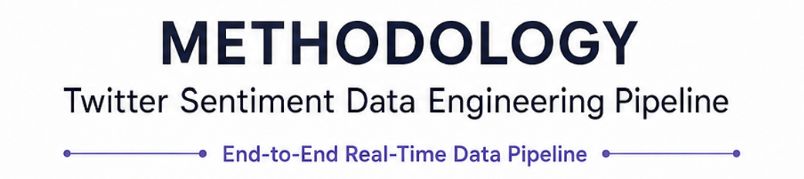
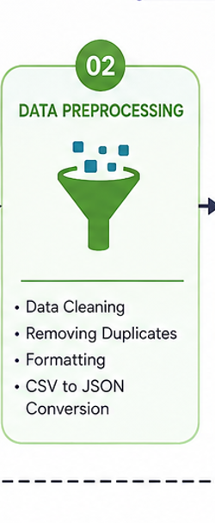
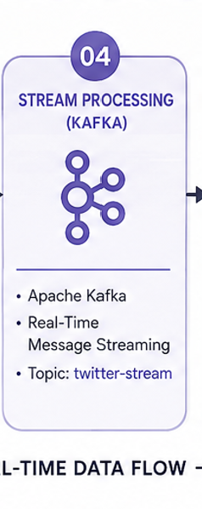
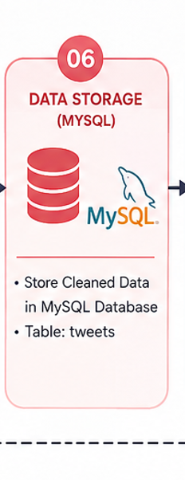
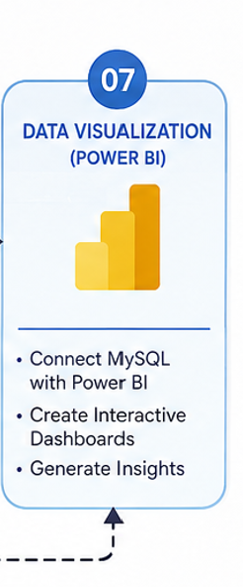
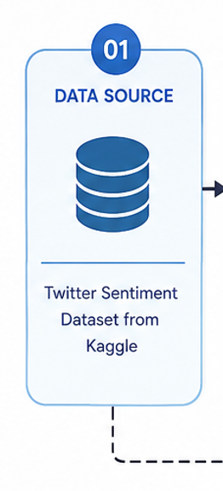
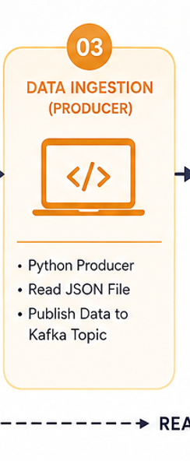
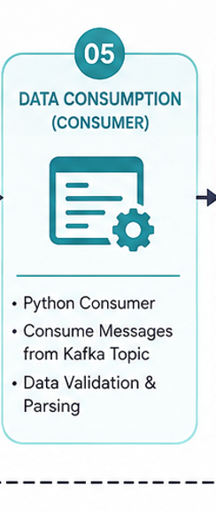
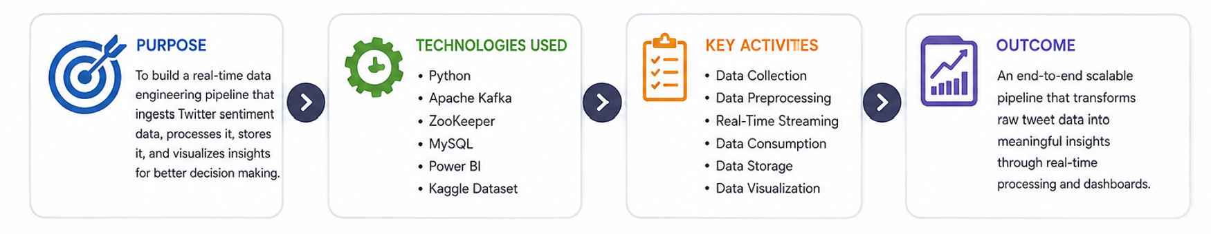

Slide 7
Technology :
Python – Used for Kafka Producer and Consumer development
Apache Kafka – Used for real-time data streaming
Zookeeper – Used for Kafka coordination and management
Java 17 – Runtime environment required for Kafka services
JSON – Used as the streaming data format
Power BI – Used for analytics and dashboard visualization

Slide 8
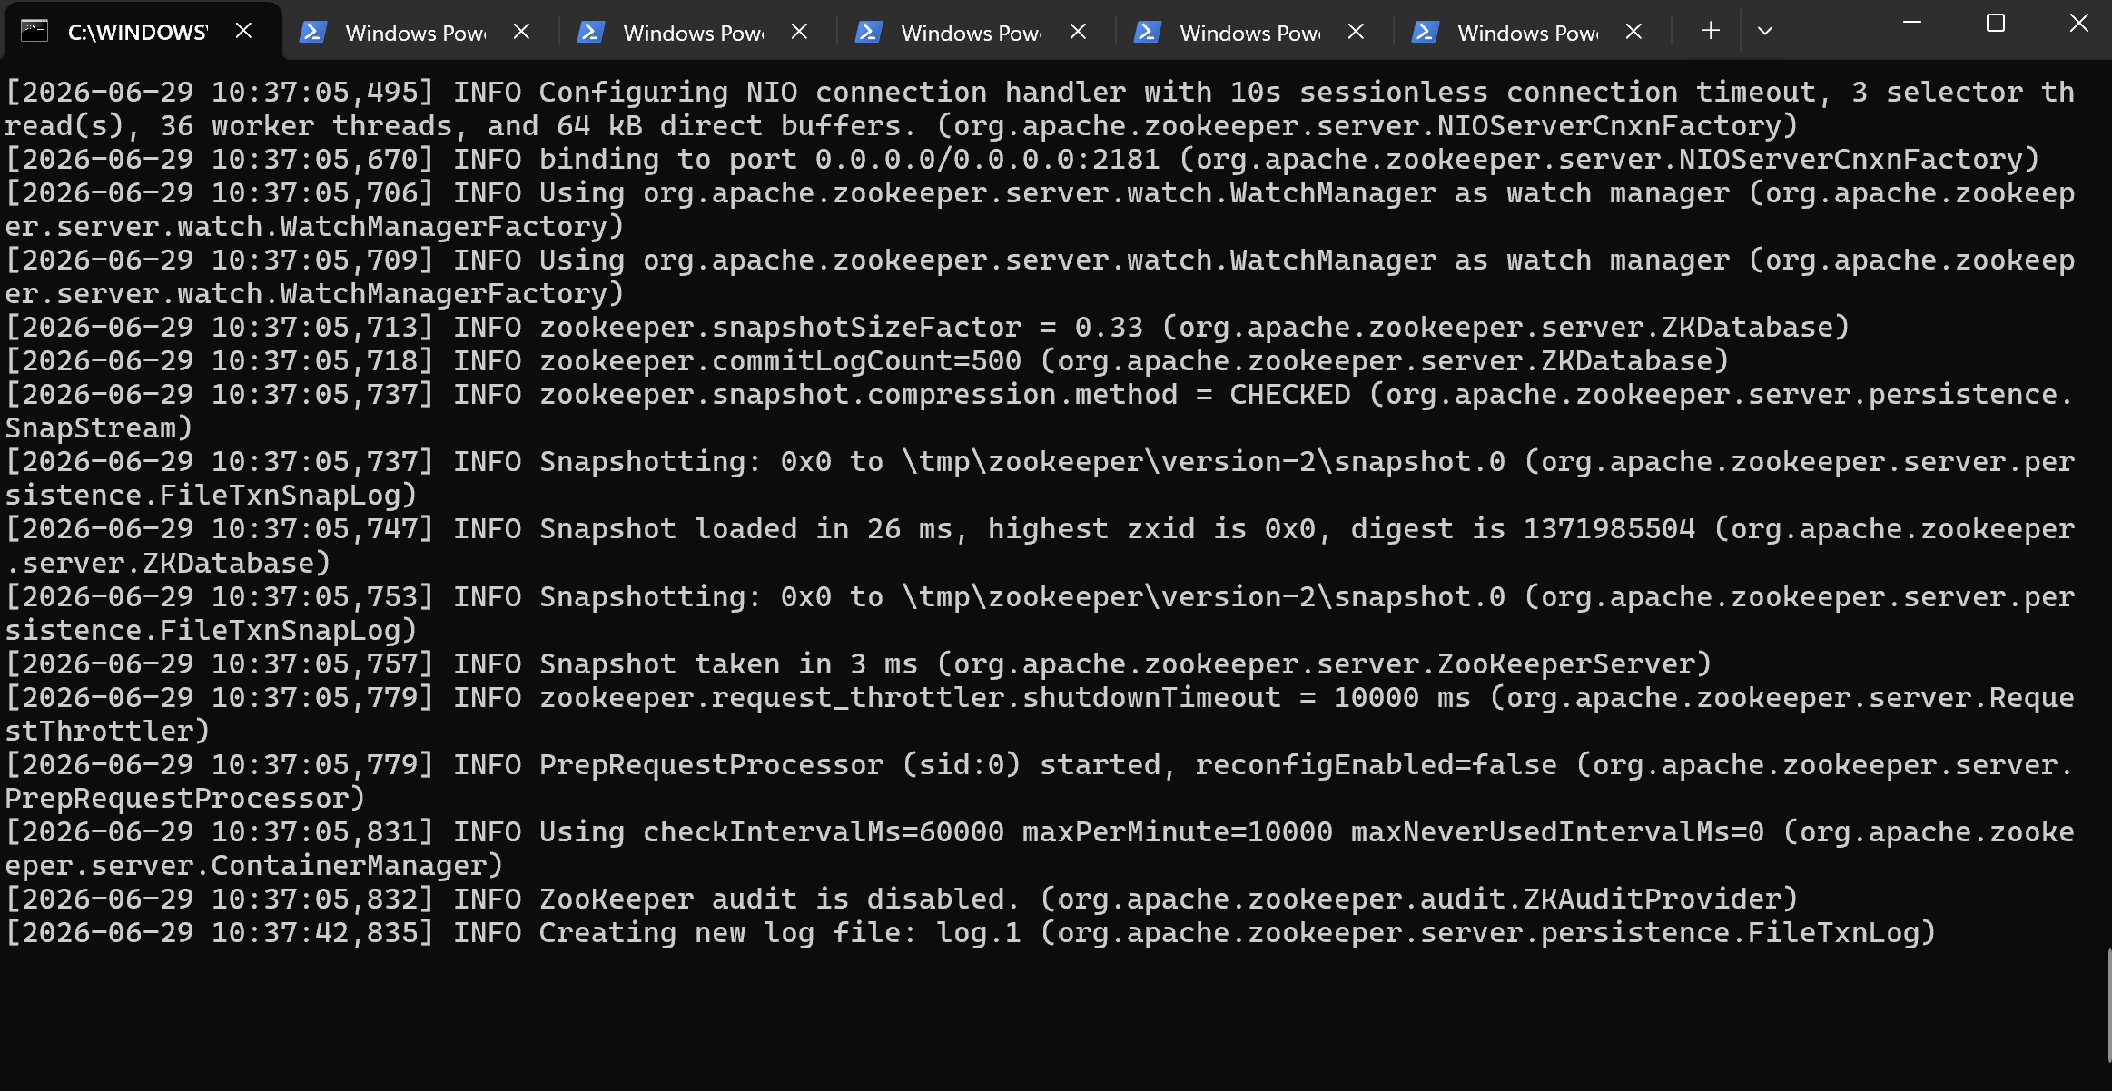
Kafka Implementation:

Slide 9
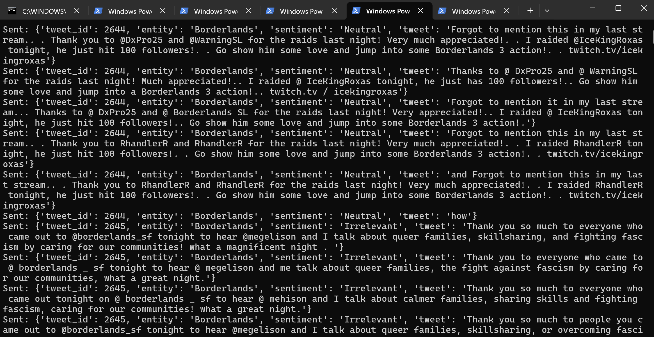
Producer:

Slide 10
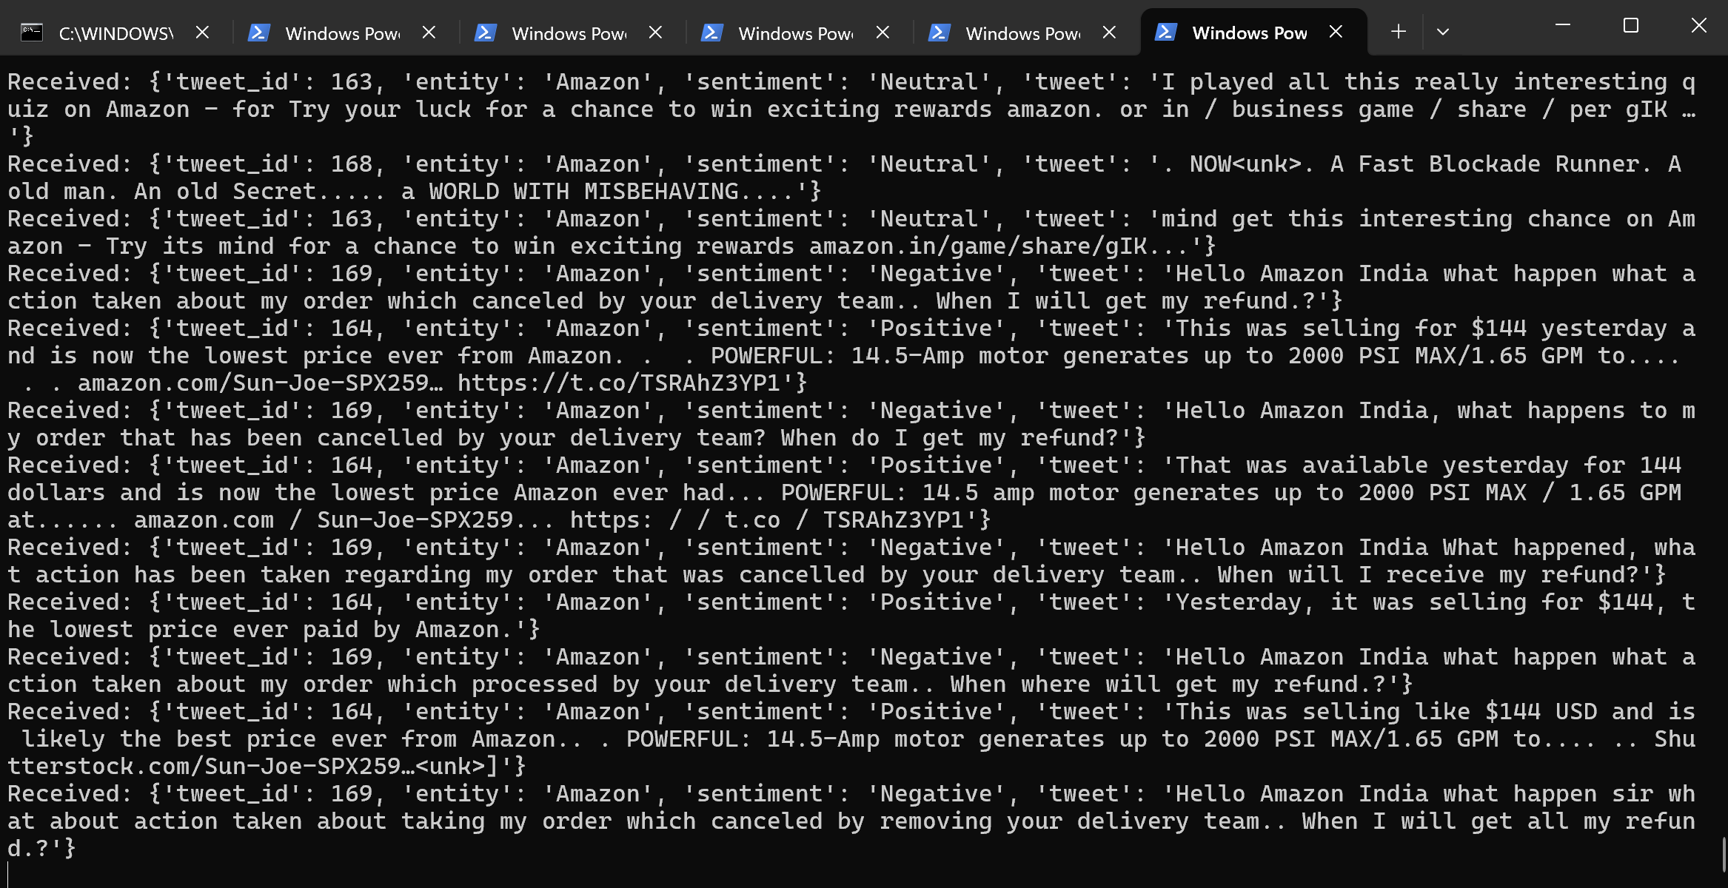
Consumer:

Slide 11
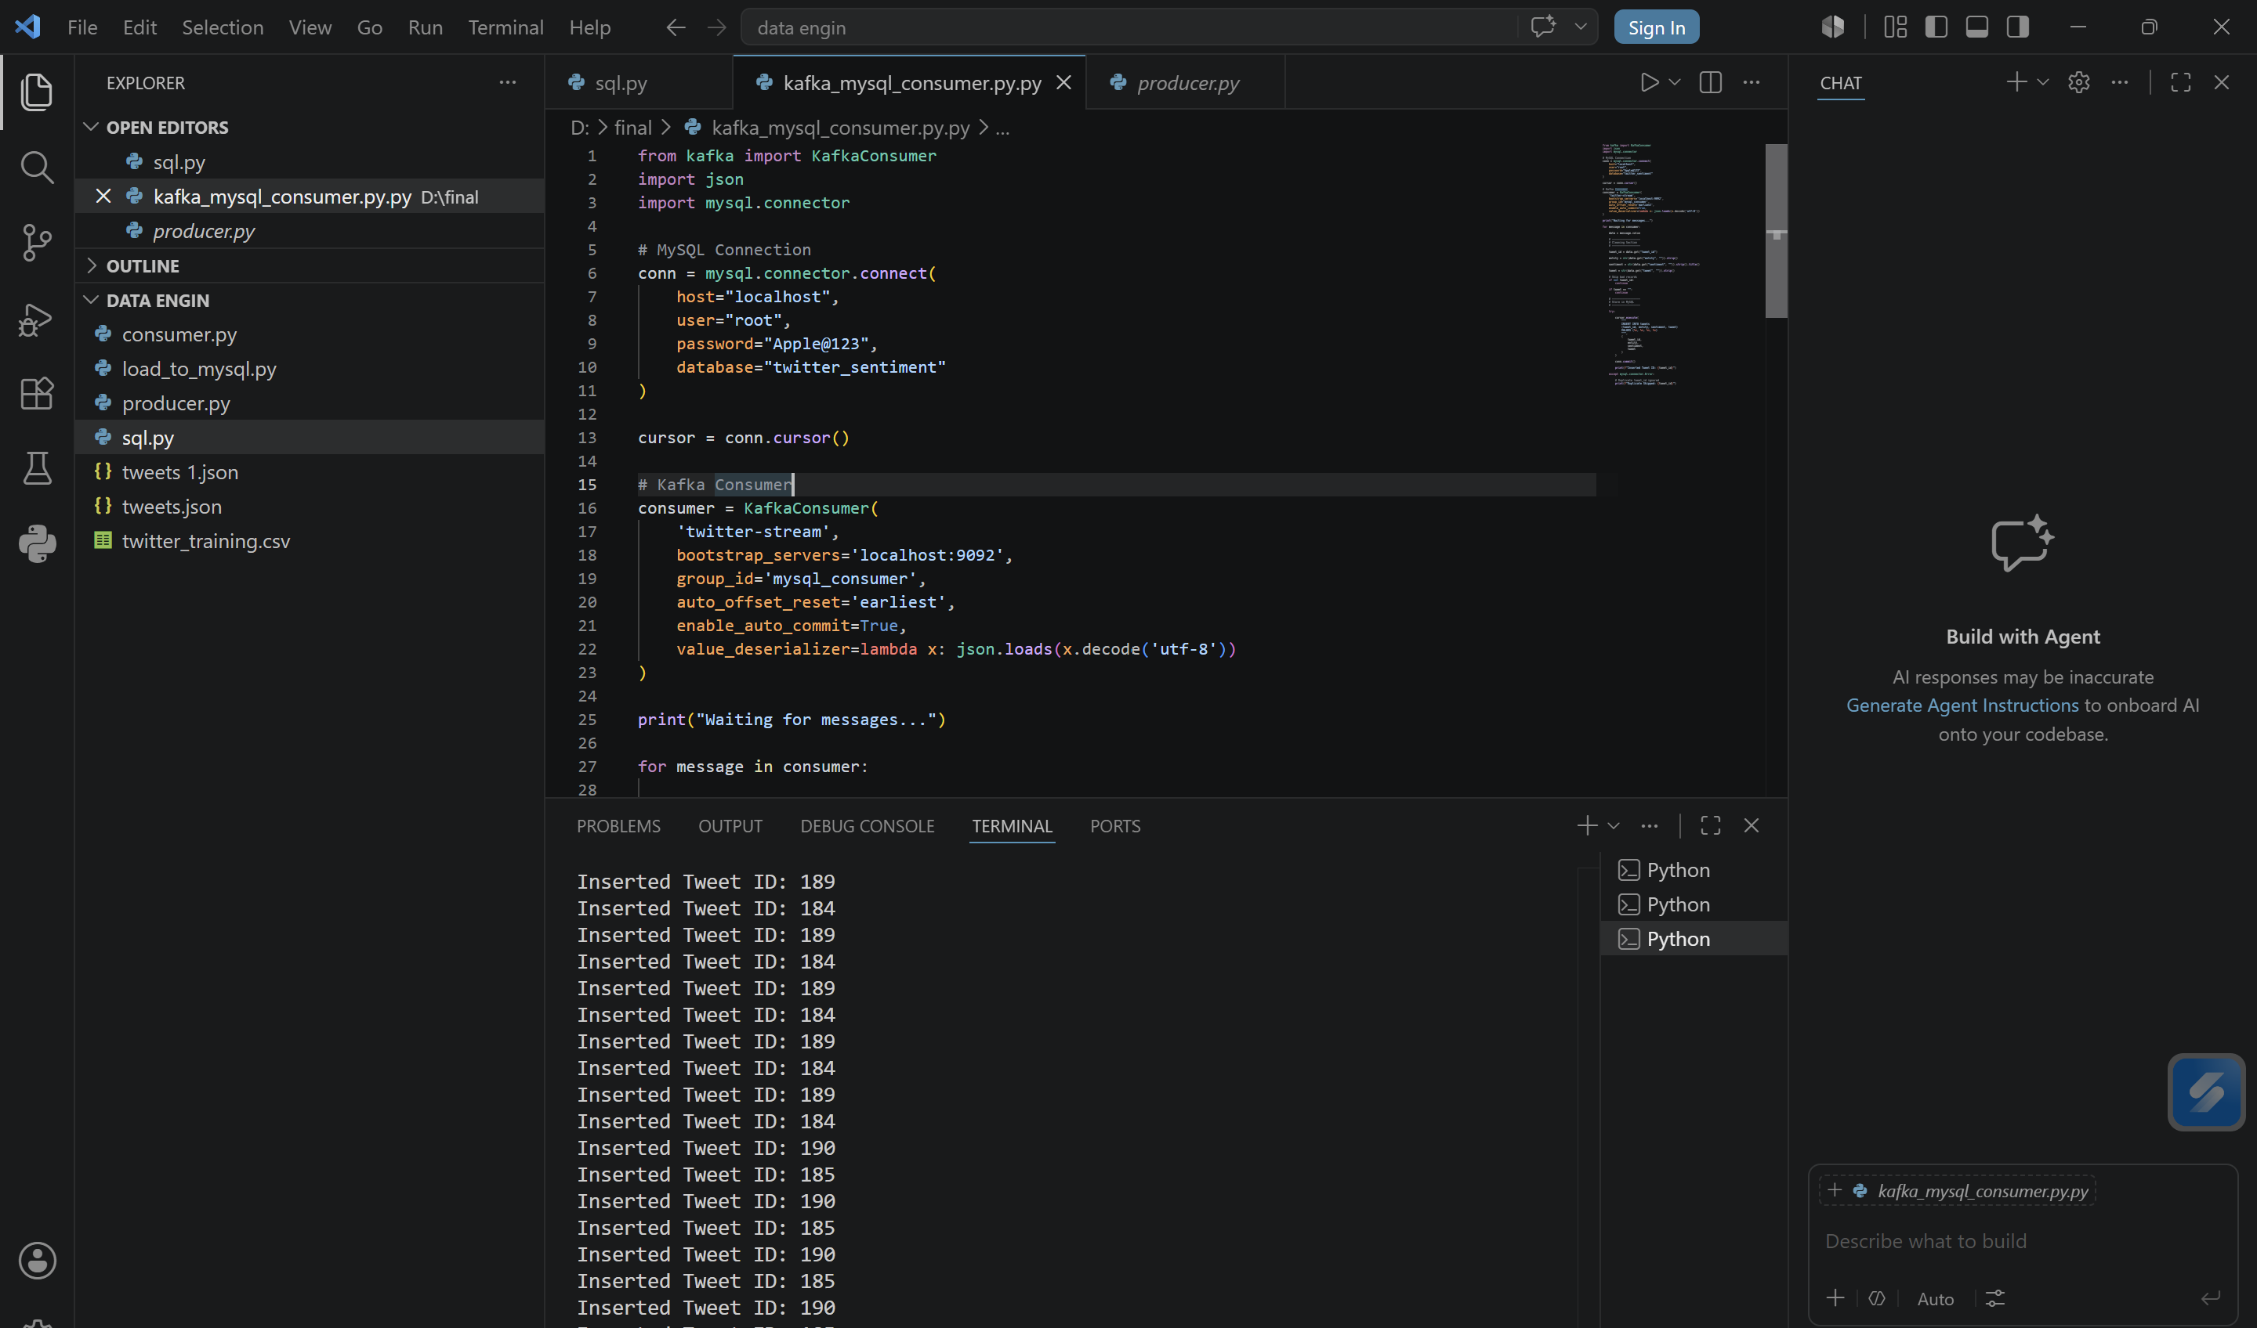
Data Cleaning and Loading into MySQL:

Slide 12
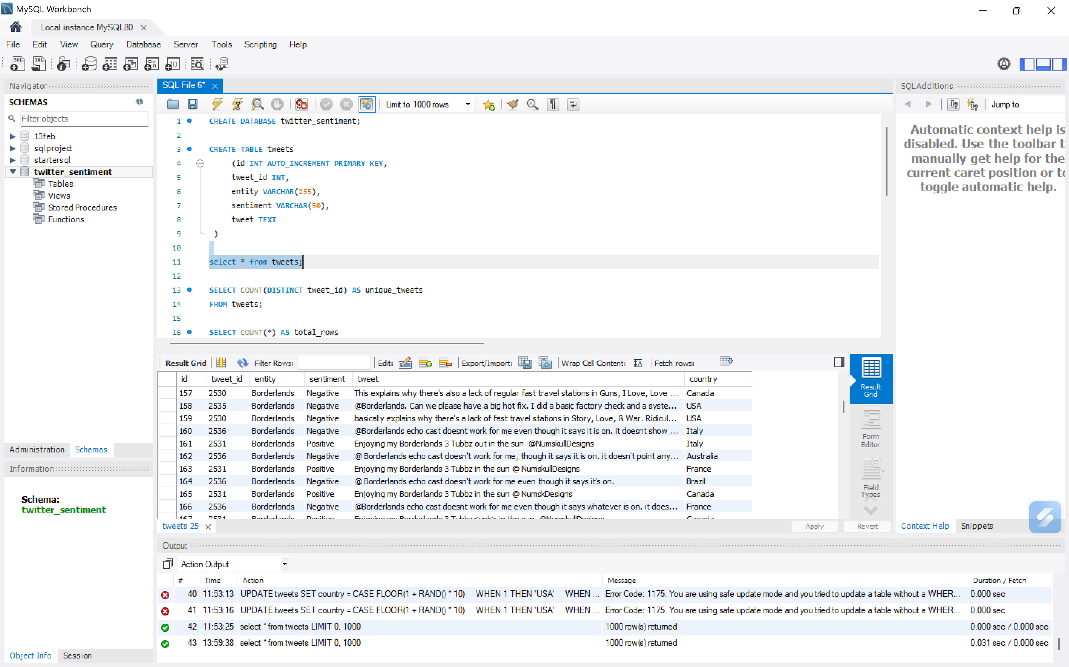
Processed Data Stored in MySQL:

Slide 13
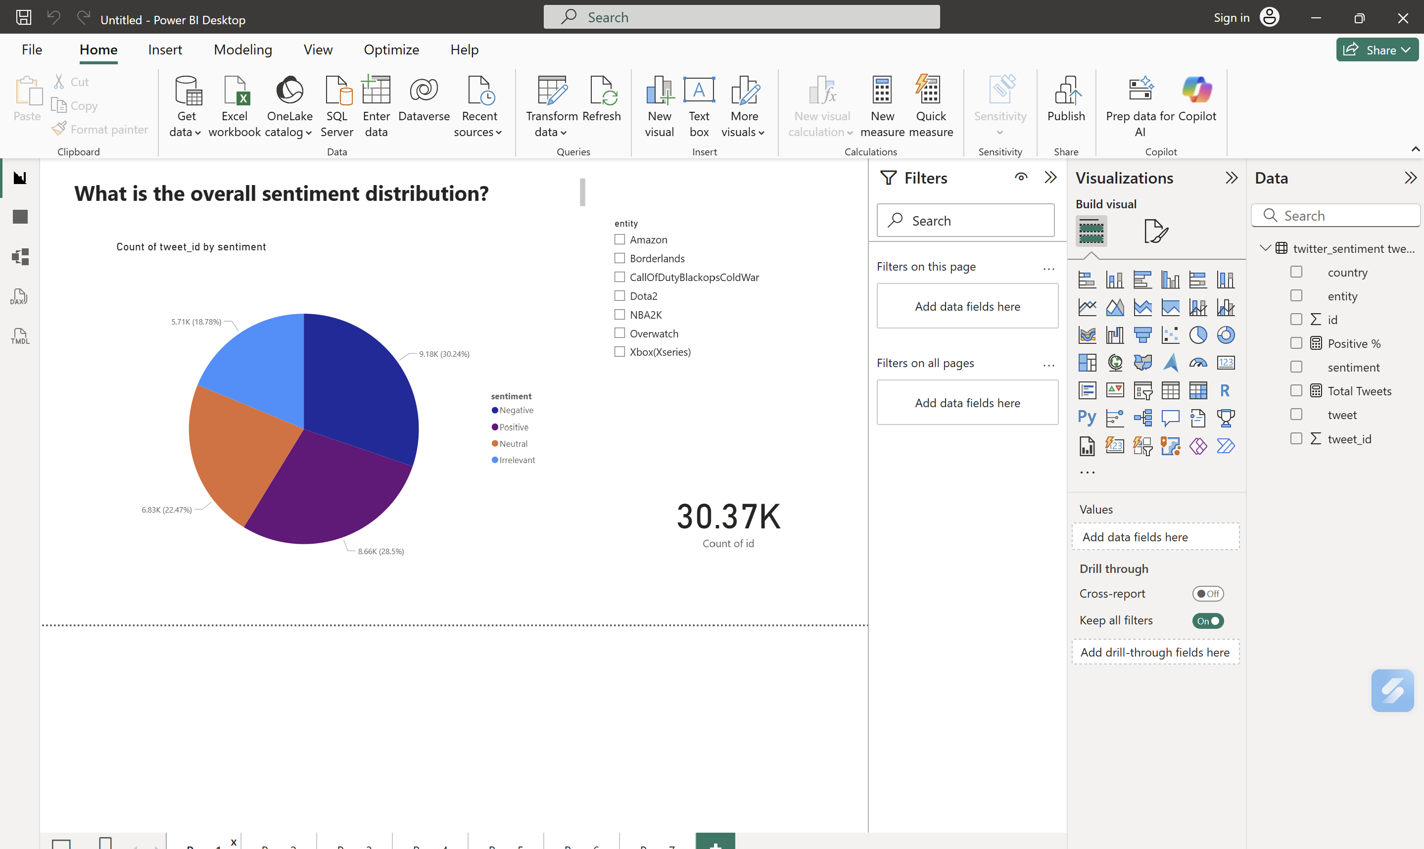
Results

Slide 14
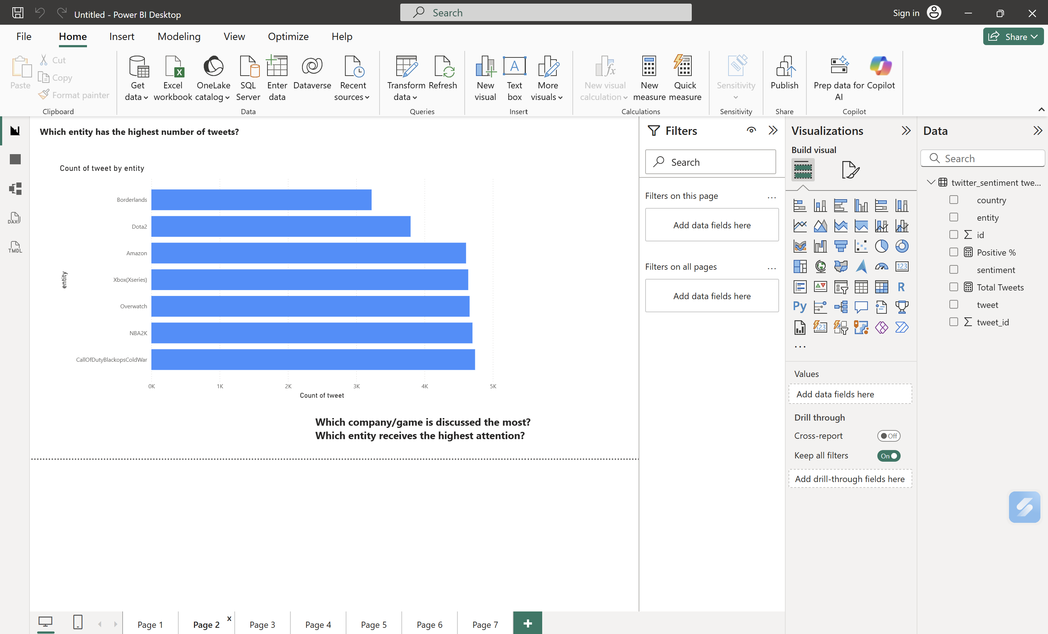
Results

Slide 15
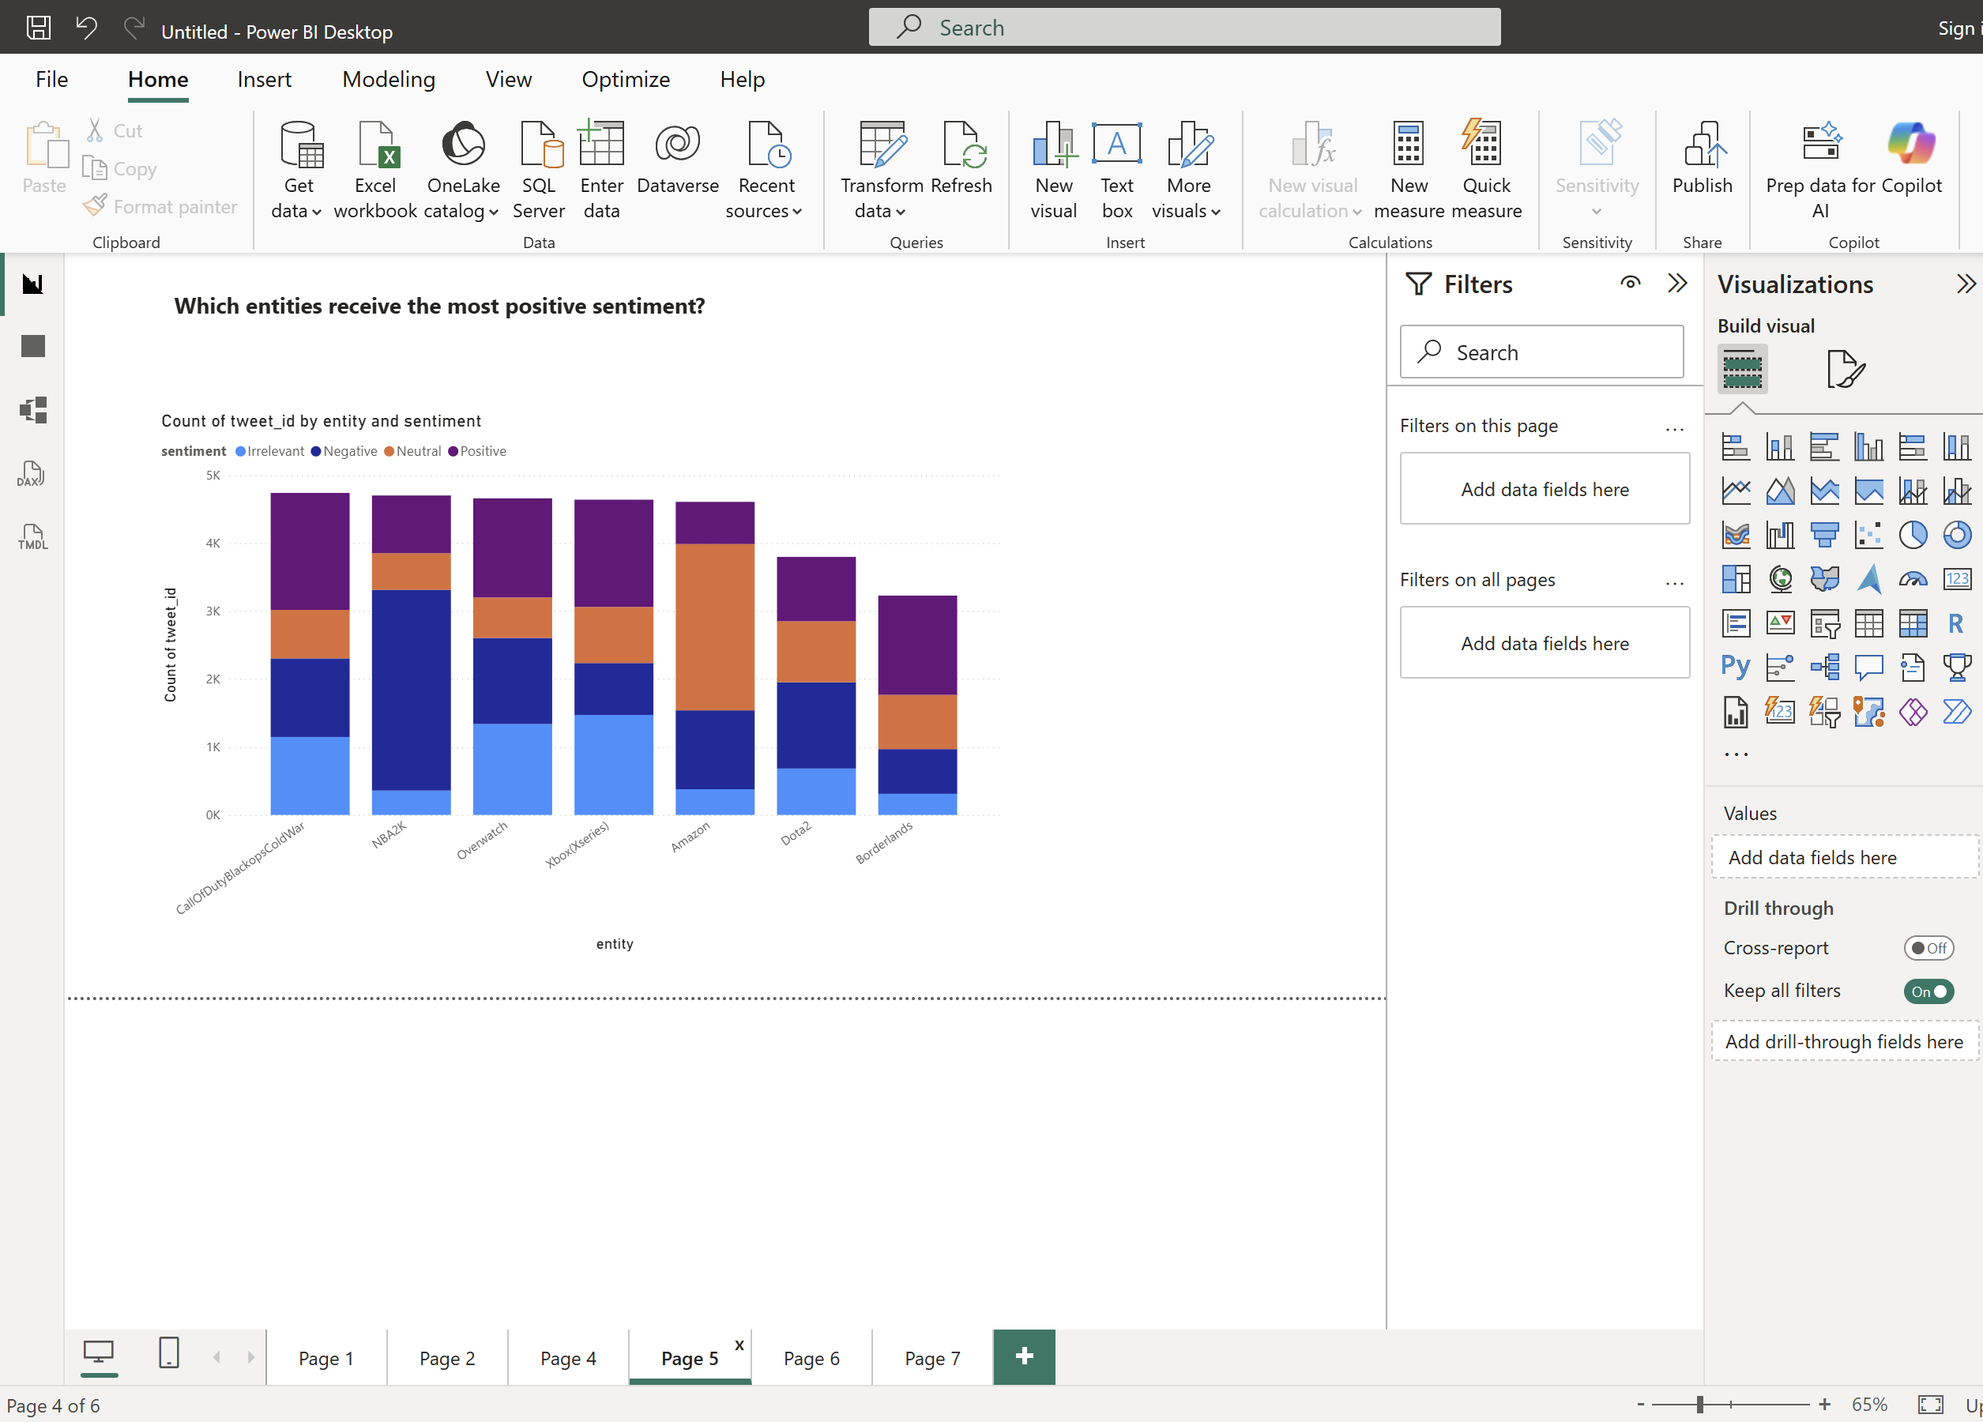
Results

Slide 16
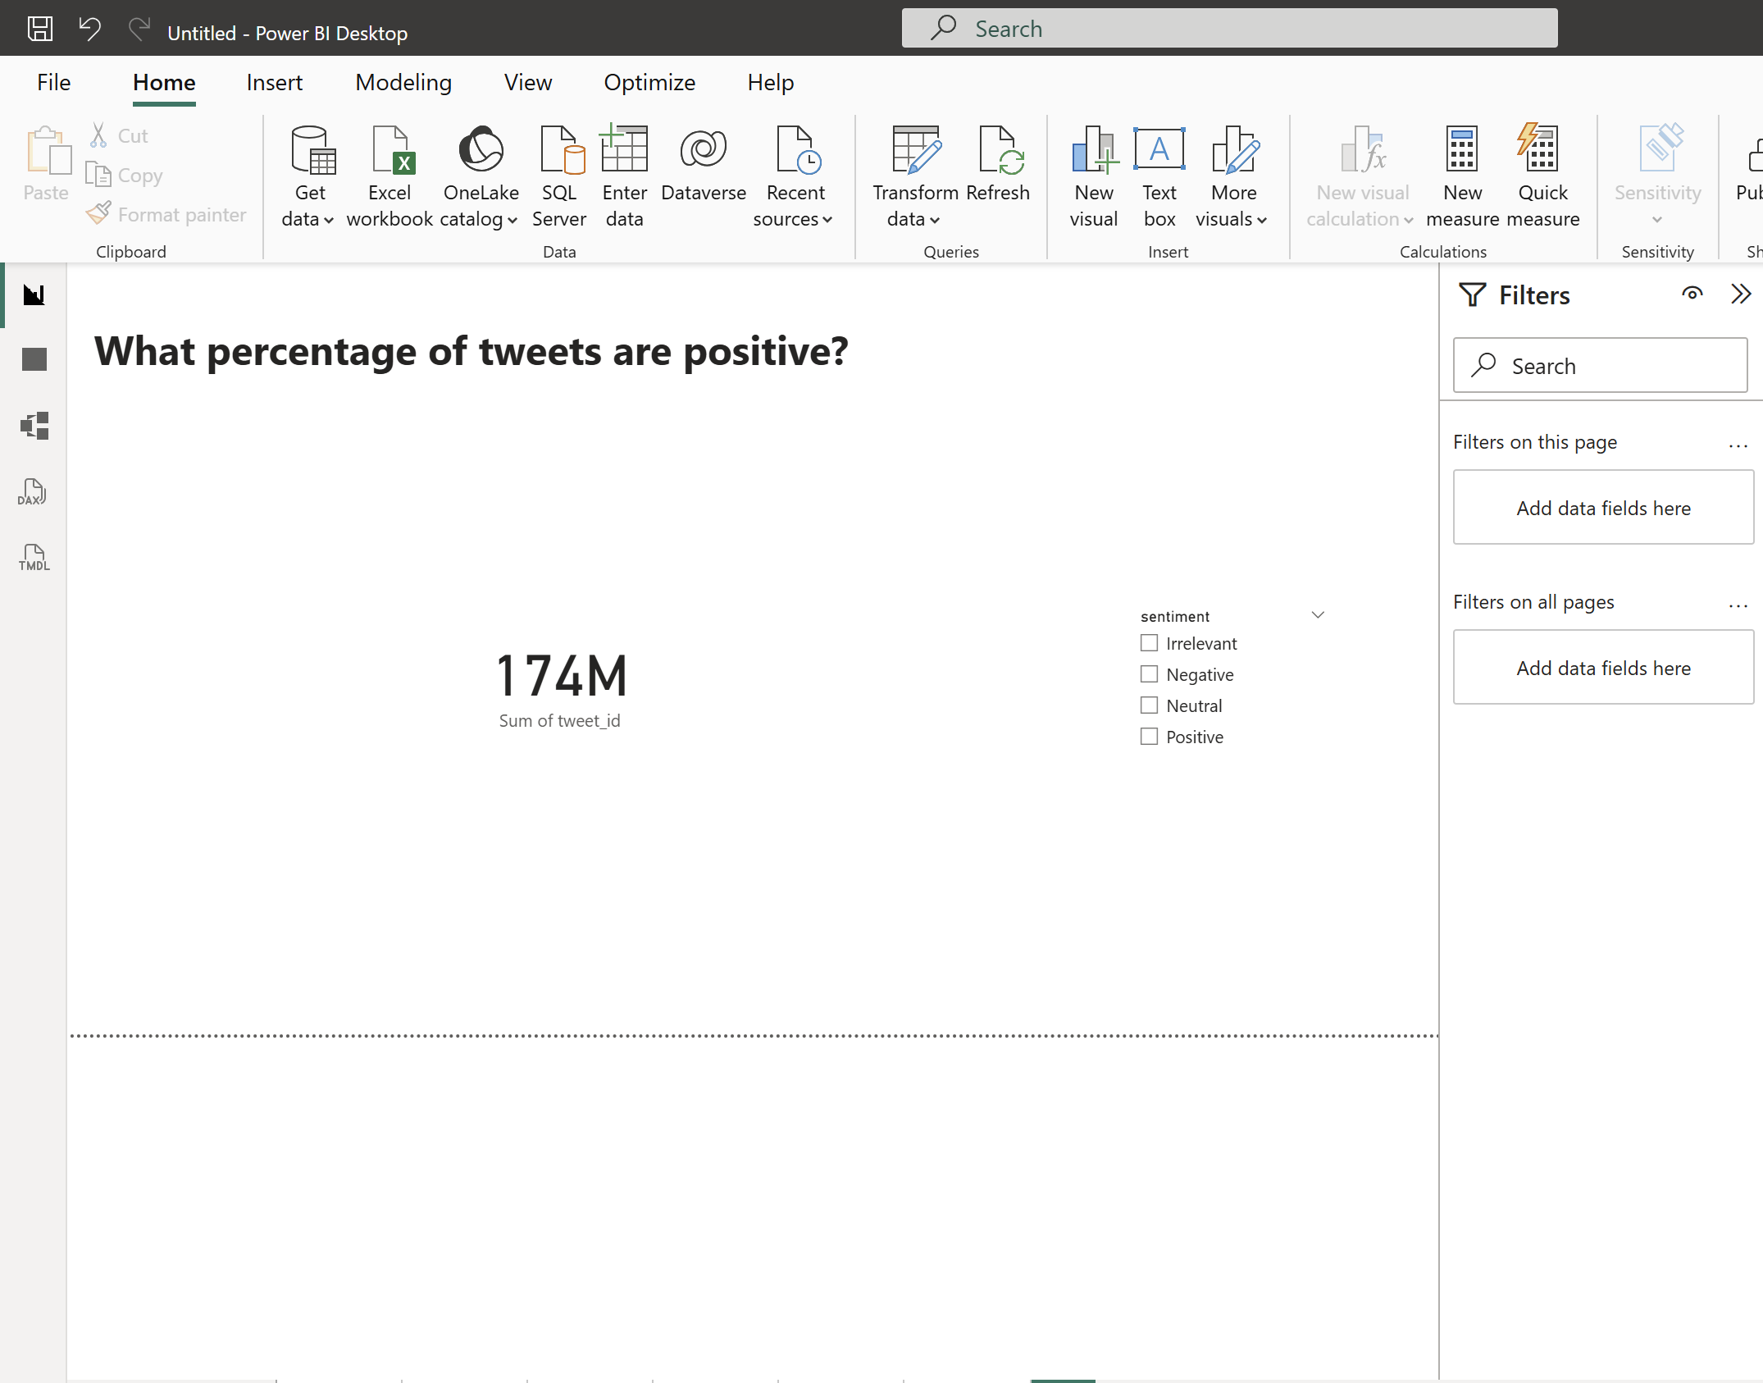
Results

Slide 17
Challenges
Team restructuring due to some members deferring to another intake.
Twitter API access limitations.
Kafka and ZooKeeper configuration.
Duplicate data handling in MySQL.
Integration of multiple technologies.
Power BI connectivity and data refresh.

Slide 18
Conclusion
Successfully developed an end-to-end data engineering pipeline.
Kafka enabled simulated real-time data streaming.
MySQL stored processed tweet data.
Power BI provided interactive visualizations.
The project demonstrates practical data ingestion, streaming, storage, and analytics.

Slide 19
Thank You!

